Slide 1
Digital Portfolio
STUDENT NAME: V POOJASRI
REGISTER NO AND NMID: 2428B0237,2A232E7E43D4D0E86AA4F315FEA4CB8B
DEPARTMENT: BSC COMPUTER SCIENCE WITH DATA ANALYTICS
COLLEGE: COLLEGE/ UNIVERSITY TIRUPPUR KUMARAN COLLEGE FOR WOMEN/BHARATHIYAR UNIVERSITY

Slide 2
PROJECT TITLE
MY DIGITAL PORTFOLIO

Slide 3


AGENDA
Problem Statement
Project Overview
End Users
Tools and Technologies
Portfolio design and Layout
Features and Functionality
Results and Screenshots
Conclusion
Github Link
3/21/2024 Annual Review

Slide 4

PROBLEM STATEMENT
The government maintains records of its employees in different departments. Each employee has details such as! · Employee ID · Name · Designation · Department · Salary You need to design a program to create and display a portfolio of a government employee. Requirements. 1. The program should allow the user to enter employee detaills. 2. The program should store the details (using variables, arrays, or a class/structure). 3. The program should provide an option to display the portfolio in a neat format. 4.(Optional for advanced level) Extend the program to store multiple employees and display their portfolios.

Slide 5

PROJECT OVERVIEW
The Government Employee Management System is a simple software project designed to store, manage, and display the details of government employees. This project helps in maintaining a digital porfolio of employees working in different departments of the government. · Obiective The main objective of this project is to create an easy-to-use system that: . Stores employee deta ils such as Employee ID, Name, Designation, Department, and Salary. ·Displays employee information in a clear and organized format. · Reduces paperwork and provides quick access to employee records. Scope This project can be used by. · Government offices for maintaining staff records. · HR departments for tracking employee details. · Educational purposes to understand the basics of data storage and portfolio cr in programming.

Slide 6

WHO ARE THE END USERS?
1.Government Employees • Can view and verify their personal details(ID designation, department, salary, etc.). O Helps them keep a record of their service profile. 2.Government HR/ Administrative Departments o Use the system to maintain employee records in digital format. O Useful for salary processing, promotions, transfers, and service history. 3.Department Heads / Supervisors o Can quickly access employee portfolios to allocate work or verify details. 4.Government Auditors / Higher Authorities 。Use the data for inspections, audits, or workforce planning 5.Students / Learners (if project is academic)oHelps in understanding how employee management systems work in real life.

Slide 7

TOOLS AND TECHNIQUES
1.HTML (Bhlyperlext Markup Language): o Used to design the structure of the portfolio web page. 0 Defines sections such as Employee ID, Name, Designation, Department, and Salary.2.CSS(Cascading Style Sheets): o Used for styling the portfolio. • Helps in creating a professional layout, colors, fonts, and responsive design. 3.JavaScript: oAdds interactivity to the portfolio page. O Used to validate employee input, dynamically update employee details, and display the portfolio neatly. 4.Text Editor / IDE: oVS Code, Sublime Text, or Notepad++ for writing code. 5.Web Browser. O Chrome, Edge, or Firefox to run and test the portfolio project.

Slide 8
POTFOLIO DESIGN AND LAYOUT
The design of the Government Employee Portfolio focuses on simplicity, readability, and professionalism. The layout is structured to display employee details such as. ·Employee ID · Name ·Designation · Department ·Salary The page is divided into sections to make the portfolio easy to read and visually appealing Layout Features 1.Header Section: · Displays the title “Government Employee Portfolio” at the top. O Styled with a bold font and back ground color for emphasis. 2.Employee Information Section:o A card-style layout is used. O Details such as Emr’e ID, Name, Designation, Department, and S. Re neatly aligned.
8

Slide 9
FEATURES AND FUNCTIONALITY
Features 1.Employee Information Storage o Stores essential details such as Employee ID Name, Designation, Department, and Salary. 2.Simple & User-Friendly Interface · Easy navigation and neatly organized portfolio design. 3.Dynamic Display · Employee details are displayed in a structured and professional format.
Functionality 1.Input Employee Details oUser can enter details such as Employee ID, Name, Designation, Department, and Salary. 2.Process Data o Program validates and stores the entered details. 3.Display Portfolio o Details are shown in a clean, card-style format that looks like a professional employee profile

Slide 10
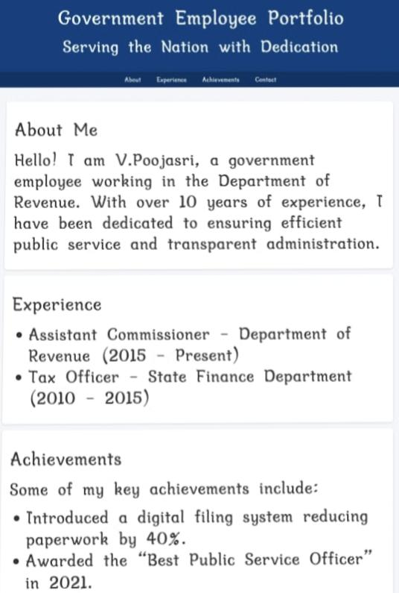

RESULTS AND SCREENSHOTS
3/21/2024 Annual Review
10

Slide 11
CONCLUSION
The Government Employee Portfolio Project provides a simple and effective way to maintain and display employee details in a structured format. It reduces paperwork, improves accessibility, and ensures that important information such as Employee ID, Name, Designation, Department, and Salary can be easily recorded and retrieved. By using tools like HTML, CSS, and JavaScript (for web version) or Python/C/Java(for programming version) the project demonstrates how technology can be applied to digital record keeping in government sectors.
11

